Slide 1
Budweiser’s Craft Beers and Breweries study
MSDS 6306: Case Study 01
Troy McSimov, Katon Pang

Slide 2
Topics
Topics

Slide 3
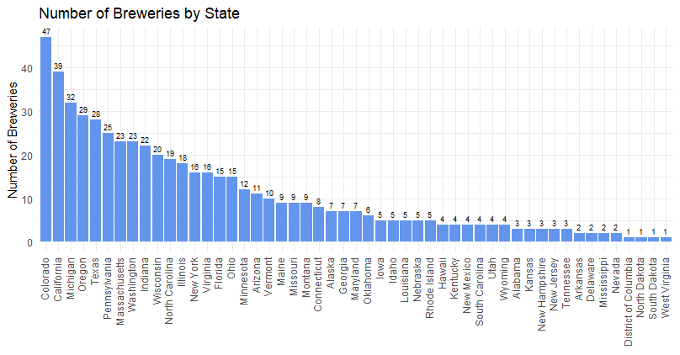
Number of Breweries by State

Slide 4
Addressing Missing Values
Original data:
ABV missing: 62 out of 2410 = 2.6%
IBV missing: 1005 out of 2410 = 42%
Style missing: 5
After the missing values lookup:
ABV missing: 15 out of 2410 = 0.6%
IBV missing: 944 out of 2410 = 39%
Style missing: 3
After impute IBV missing values:
IBV missing: 11 out of 2410 = 0.46%

Slide 5
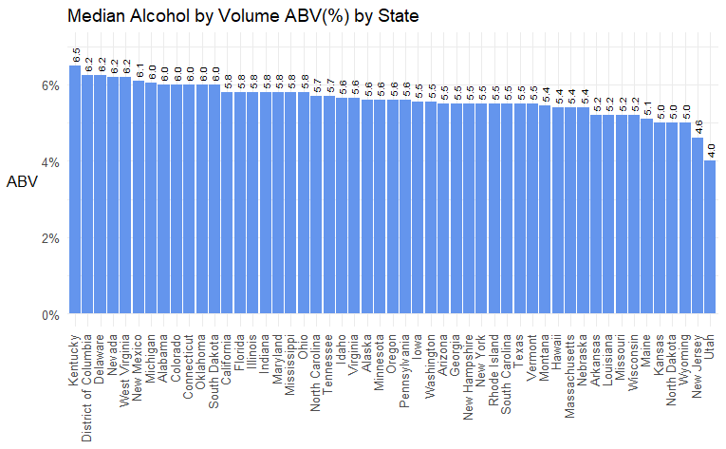
Median APV and IBU by State

Slide 6
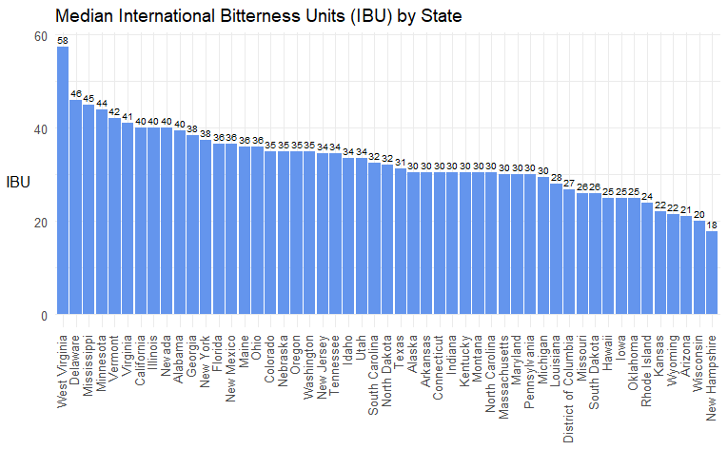
Median APV and IBU by State

Slide 7
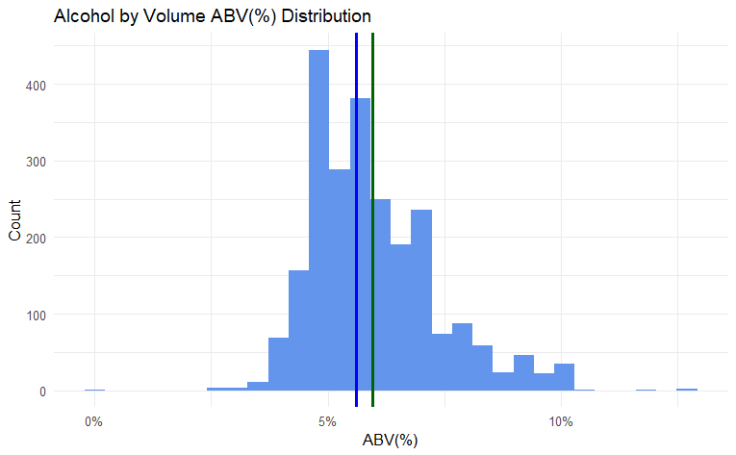
APV Statistics
Min = 0.1%
1st Quantile (25%) = 5.0%
Median = 5.6%
Mean = 5.97%
3rd Quantile (75%) = 6.7%
Max = 12.8%
Standard Deviation = 1.35%

Slide 8
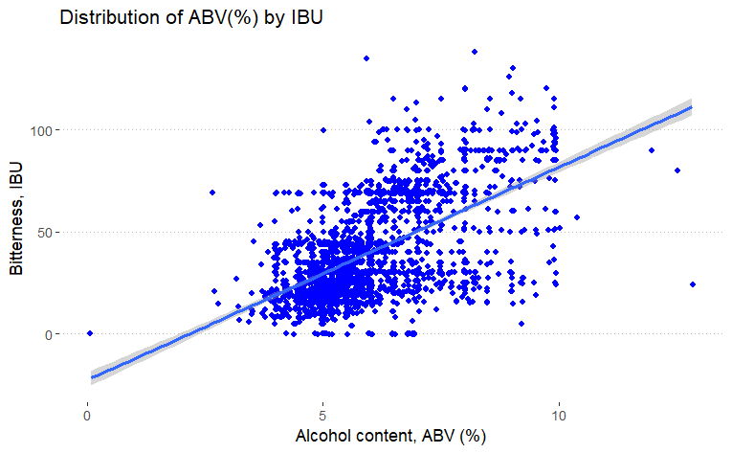
APV vs. IBU

